Slide 1




Slide 2
About IntelliJ autocomplete
Type-aware
Has chain completion
View quick definition
Doesn’t work same with tab and enter keys
Completion for file names, resources, etc.

Slide 3

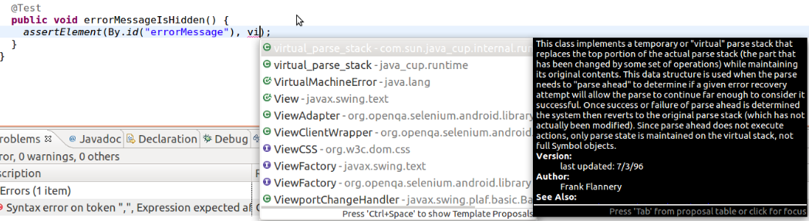
Type-aware

Slide 4
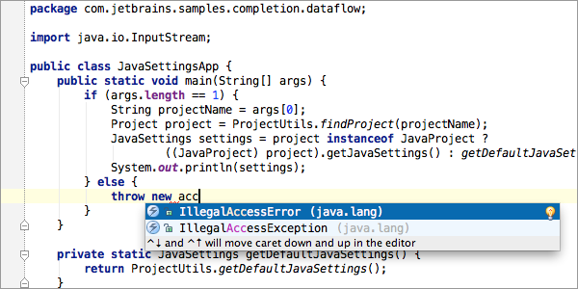
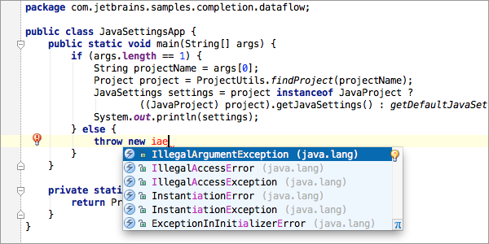
Middle matching and camel humps completion

Slide 5
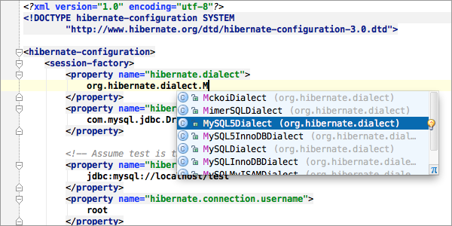
XML Java Files Completion

Slide 6
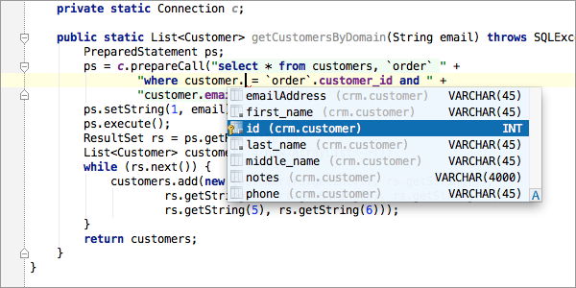
Language injection

Slide 7
Honorable mentions
Eclipse compiler and shortcuts, IntelliJ has them
Refactoring
Indexing
Better looking UI

Slide 8
https://dzone.com/articles/top-20-code-completions-in-intellij-idea
http://blog.dripstat.com/why-you-should-use-the-eclipse-compiler-in
https://dzone.com/articles/why-idea-better-eclipse

